Slide 1

CMSC204
Kartchner
V(StateGraph) = {Oregon, Alaska, Texas, Hawaii, Vermont, NewYork, California}
E(StateGraph) = {(Alaska, Oregon), (Hawaii, Alaska), (Hawaii, Texas), (Texas, Hawaii), (Hawaii, California), (Hawaii, New York), (Texas, Vermont), (Vermont, California), (Vermont, Alaska)}
1. Draw the StateGraph
i
A
V
a
O
h
g
N
c
H
d
T
e
C
f

Slide 2
a. Show the adjacency matrix that would describe the edges in the graph. Store the vertices in alphabetical order
States
A C H N O T V
Alaska
California
Hawaii
New York
Oregon
Texas
Vermont
0 0 0 0 1 0 0
0 0 0 0 0 0 0
1 1 0 1 0 1 0
0 0 0 0 0 0 0
0 0 0 0 0 0 0
0 0 1 0 0 0 1
1 1 0 0 0 0 0
3. b. Show the adjacency lists
that would describe the edges in the graph
Alaska
California
Hawaii
New York
Oregon
Texas
Vermont
Oregon
Alaska
California
New York
Texas
Hawaii
Vermont
Alaska
California

Slide 3
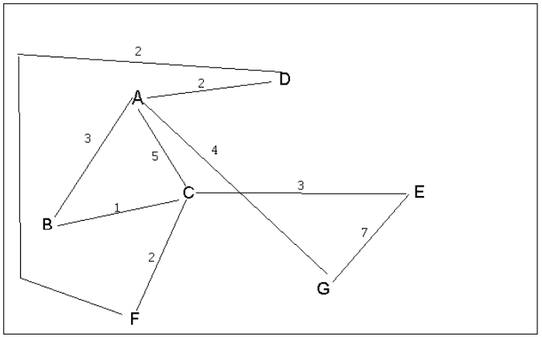
4 a. Which of the following lists the graph nodes in depth first order beginning with E?
A) E, G, F, C, D, B, A
B) G, A, E, C, B, F, D
C) E, G, A, D, F, C, B
D) E, C, F, B, A, D, G
4 b. Which of the following lists the graph nodes in breadth first order beginning at F?
A) F, C, D, A, B, E, G
B) F, D, C, A, B, C, G
C) F, C, D, B, G, A, E
D) a, b, and c are all breadth first traversals

Slide 4
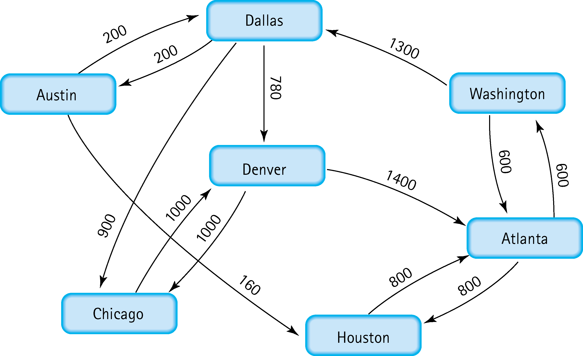
5. Find the shortest distance from Atlanta to every other city
Atlanta -> Houston : 800
Atlanta -> Washington : 600
Atlanta -> Denver: Atlanta – Washington – Dallas – Denver : 2680
Atlanta -> Dallas : Atlanta – Washington – Dallas : 1900
Atlanta -> Chicago : Atlanta – Washington – Dallas – Chicago: 2800
Atlanta -> Austin: Atlanta – Washington – Dallas – Austin: 2100

Slide 5
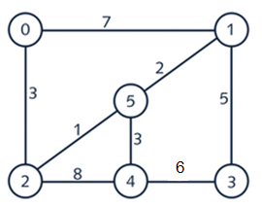
6. Find the minimal spanning tree using Prim’s algorithm. Use
0 as the source vertex . Show the steps.
Step 1: Take the starting vertice 0 and join vertice 2 because it is directly connected and has the minimum weight in directly connected edges
0->2 : 3
Step 2: Take the starting vertice 2 and join vertice 5 because it is directly connected and has the minimum weight in directly connected edges
2->5 :1
Step 3: Take the starting vertice 5 and join vertice 1 because it is directly connected and has the minimum weight in directly connected edges
5->1 :2
Step 4: Take the starting vertice 5 and join vertice 1 because it is directly connected and has the minimum weight in directly connected edges
5->4 :3
Step 5: Take the starting vertice 1 and join vertice 3 because it is directly connected and has the minimum weight in directly connected edges
1->3 :5

Slide 6
7. Find the minimal spanning tree using Kruskal’s algorithm.
Show the weights in order and the steps.
Weights in ascending order:
weight_list = {1,2,3,3,5,6,7,8}
Step 1: Taking 1 from the weight list and forming the edge for it
2 - > 5 : 1
Updated weight_list = {2,3,3,5,6,7,8}
Step 2: Take 2 from the weight list and form the edge for it.
5 -> 1: 2
Updated weight_list = {3,3,5,6,7,8}
Step 3: Take 3 from the weight list and form the edge for it.
0 -> 2: 3
Updated weight_list = {3,5,6,7,8}
Step 4: Take 3 from the weight list and form the edge for it.
5 -> 4: 3
Updated weight_list = {5,6,7,8}
Step 5: Take 5 from the weight list and form the edge for it.
1 -> 3: 5
Updated weight_list = {5,6,7,8}

Slide 7
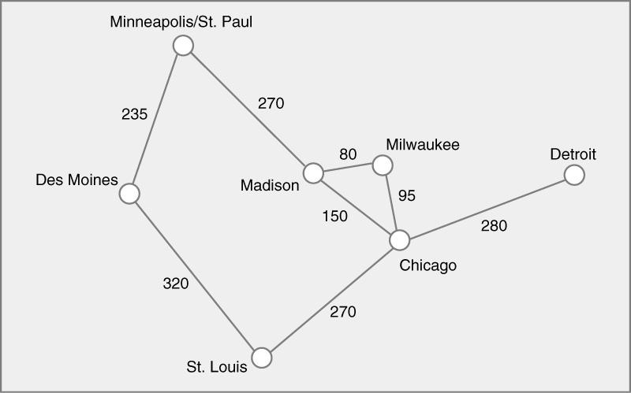
8. Find the minimal spanning tree using the algorithm you prefer. Use
Minneapolis/St. Paul as the source vertex
Mineapolis
Milwaukee
270
80
235
Madison
95
Detroit
Chicago
280
Des Moines
270
V(T) = {0,1,2,3,4,5,6}
E(T) = {(0,1),(0,3),(3,4),(4,5),(5,2),(5,6)}
St.Louis

Slide 8
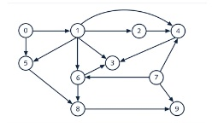
9. List the nodes of the graph in a breadth first topological ordering. Show the
steps using arrays predCount, topologicalOrder and a queue
Step 1: Find the number of predecessor of each vertex
Step 2: Remove 0 – pred vertice from graph and put in queue
Step 3: Repeat 1 and 2 until we have an empty graph
Step 4: Queue = topological order
Topological order:
0
7
1
2
5
6
4
8
3
9
Pre- count | 0 | 1 | 1 | 3 | 3 | 2 | 2 | 0 | 2 | 2
Top Order | 0 | 7 | 1 | 2 | 5 | 6 | 4 | 8 | 3 | 9
Queue | 0 | 7 | 1 | 2 | 5 | 6 | 4 | 8 | 3 | 9
Pre count 1 |  | 0 | 1 | 3 | 2 | 1 | 1 |  | 2 | 1
Pre count 2 |  |  | 0 | 2 | 1 | 0 | 0 |  | 2 | 1
Precount 3 |  |  |  | 1 | 0 |  |  |  | 0 | 1
Precount 4 | 0 | 0 | 0 | 0 | 0 | 0 | 0 | 0 | 0 | 0

Slide 9
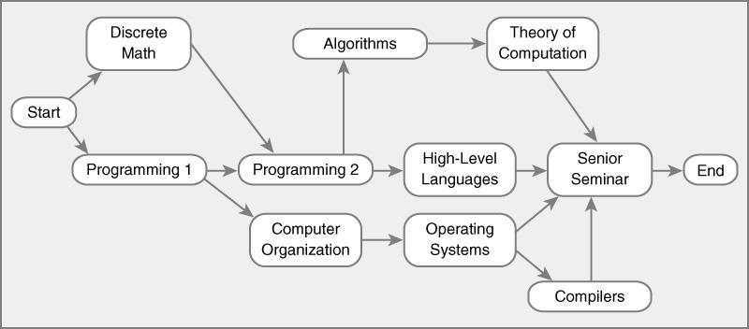
10. List the nodes of the graph in a breadth first topological ordering.
Topological order:
-----------------------
Start
Discrete Math
Programming 1
Programming 2
Computer Organization
Algorithms
Operating Systems
High-Level Languages
Theory Computation
Compilers
Senior Seminar
End

